Slide 1


Why Does House Price Prediction Matter?
From Business Problem to Production-Ready AI Solution
THE OBJECTIVE
THE OUTCOME
Build an AI-powered house price prediction system.
Production-ready prediction API.
Real estate pricing is often subjective and time-consuming. Buyers and sellers need quick, data-driven estimates to make confident decisions in a fast-moving market.
Key Message: Transform raw property data into actionable pricing intelligence.

Slide 2



What Problem Are We Solving?
Current Challenges
Manual valuation takes significant time.
Pricing varies across locations and property types.
Human estimates can be inconsistent and biased.
Business Opportunity
Faster property valuation.
Improved, data-backed decision-making.
Better customer experience.
Key Message: A reliable pricing engine creates business value.

Slide 3


What Data Do We Have?
Model Features
Location & Size
Bedrooms & Bathrooms
Year Built & Condition
Property Type & Date Sold
Property Records
Target Variable
House Price
Key Message: Strong dataset with sufficient historical information for predictive modeling.

Slide 4

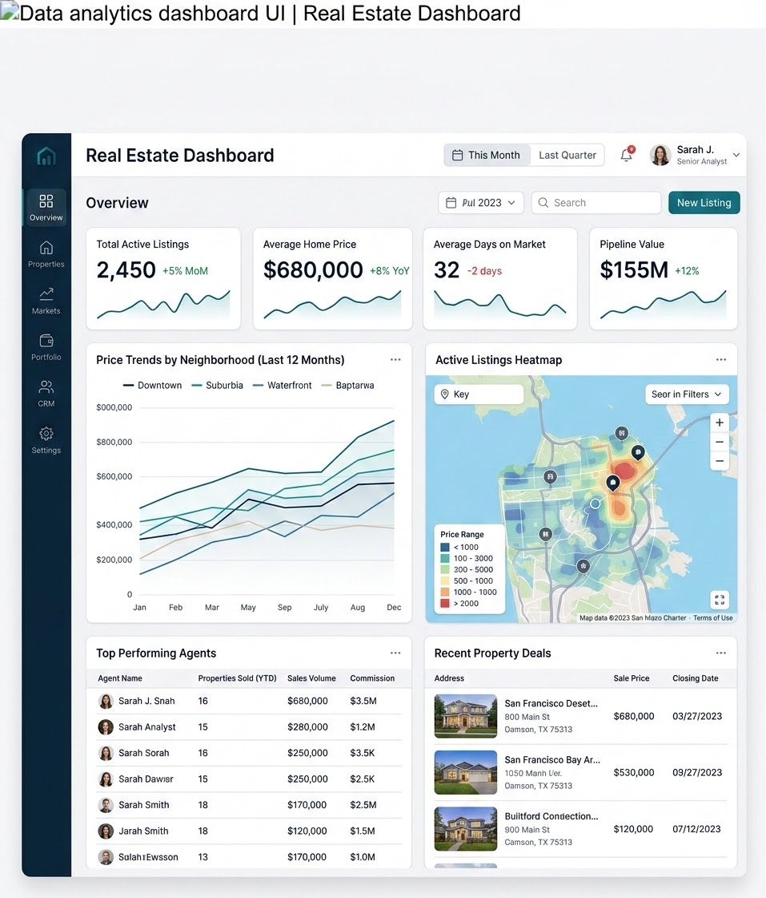
What Did the Data Reveal?
Analysis Performed
Missing value analysis
Feature distributions & Price trends
Correlation analysis
Key Insights
Size: Strongly impacts baseline price.
Location: Influences pricing significantly.
Age: Contributes directly to valuation.
Key Message: EDA helps identify meaningful drivers of house prices.

Slide 5







How Did We Improve the Data?
Why? To convert business information into machine-readable features.
Created
Removed
Encoded
Property Age
Property ID
Location
Sale Year
Raw Date Fields
Property Type
Sale Month
Condition
Key Message: Better features lead to better predictions.

Slide 6

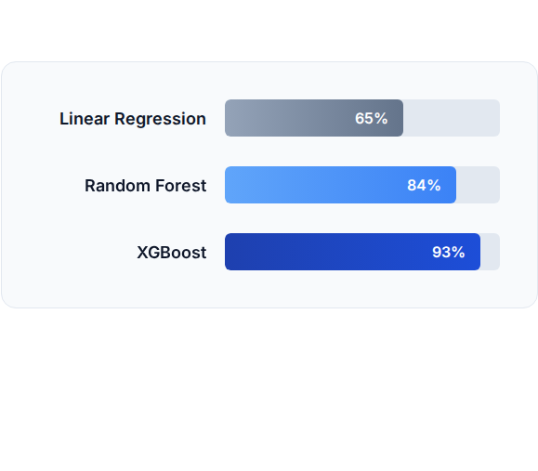
Why Compare Multiple Models?
Evaluation Metrics
R² Performance Comparison
MAE: Mean Absolute Error
RMSE: Root Mean Squared Error
R² Score: Accuracy benchmark
Why? Start simple, benchmark performance, then select the best-performing solution.
Key Message: Model selection should be evidence-driven, not assumption-driven.

Slide 7
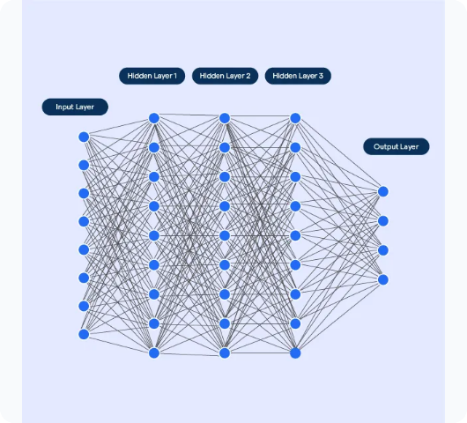
Why Was XGBoost Selected?
Technical Advantages
Handles nonlinear relationships.
Captures feature interactions.
High performance on tabular datasets.
Production-proven architecture.
Technical Decision
n_jobs = -1 (Multi-core processing)
Benefits: Faster training, better scalability.
Key Message: XGBoost balanced accuracy, scalability, and deployment readiness.

Slide 8






How Does the End-to-End System Work?
Excel Dataset
Processing
XGBoost Model
FastAPI
End User
Raw property data
Feature Engineering
Model.pkl Artifact
Prediction API
Instant Valuations
Key Message: The solution is fully automated and production-ready.

Slide 9

How Can Users Consume Predictions?
Deployment Stack
API Example
FastAPI: High-performance framework
# POST /predict
"Location"
"Downtown"
Swagger: Auto-generated API documentation
"Size_sqft"
2400
"Bedrooms"
3
"Bathrooms"
2
"Property_Age"
5
# Response
"status"
"success"
Ngrok: Secure public endpoint routing
"Predicted_Price"
450000
The API allows seamless integration into any frontend interface or internal tooling dashboard.
Key Message: Predictions are accessible through a simple and scalable API.

Slide 10







What Was Achieved?
Results
Business Impact
Future Enhancements
Accurate prediction model.
Faster valuations.
Cloud deployment (AWS/Azure)
Production-ready API.
Reduced manual effort.
Model monitoring
Multi-core training.
Improved pricing consistency.
Explainable AI (SHAP)
Scalable architecture.
Real-time retraining
Key Message: This project demonstrates the complete AI Product Engineering lifecycle: Problem Understanding → Data Analysis → Modeling → Deployment → Business Impact.

Slide 11




Image Sources
https://media.istockphoto.com/id/2208958683/vector/city-buildings-abstract-background-smart-city-urban-concept-real-estate-organization-office.jpg?s=612x612&w=0&k=20&c=qjikhzsf4166wYfmJ6rWOcPjZJeJtBRC8MZRmPDX6t4=
Source: www.istockphoto.com
https://images.stockcake.com/public/c/9/a/c9a7a5e8-a217-445c-bdf0-e740903f156c_large/modern-data-dashboard-stockcake.jpg
Source: stockcake.com
https://cdn.botpenguin.com/assets/website/Deep_Neural_Network_2b9d9075e9.webp
Source: botpenguin.com

Slide 12
Any Queries
Thank You.

